Slide 1
Machine Learning Optimization Methods and Their Application to Predicting T-Cell Differentiation Using GNNs and Reinforcement Learning
Francis Boabang
1
Notes:
Proactive prediction for haptic feedback in remote robotic surgery
Introduction
Remote Robotic Surgery (including overlapping surgery)
Haptic Feedback Prediction
Proactive Prediction
Related Work
Evaluation

Slide 2

Link to source codes

Slide 3
Content of Seminar
Presentation of 2024 Ph.D. Thesis
Application to Stem Cell Differentiation

Slide 4

Refining Optimization Methods for Training Machine Learning Models: A Case Study in Robotic Surgical Procedures 2024 Ph.D. Thesis
Francis Boabang
Link to thesis:
4
Notes:
Proactive prediction for haptic feedback in remote robotic surgery
Introduction
Remote Robotic Surgery (including overlapping surgery)
Haptic Feedback Prediction
Proactive Prediction
Related Work
Evaluation

Slide 5
Content
Introduction
Challenges
Motivation
Thesis Statement
Contribution to the Thesis
First Contribution
Second Contribution
Conclusion of the Thesis
Limitations
Future Work

Slide 6
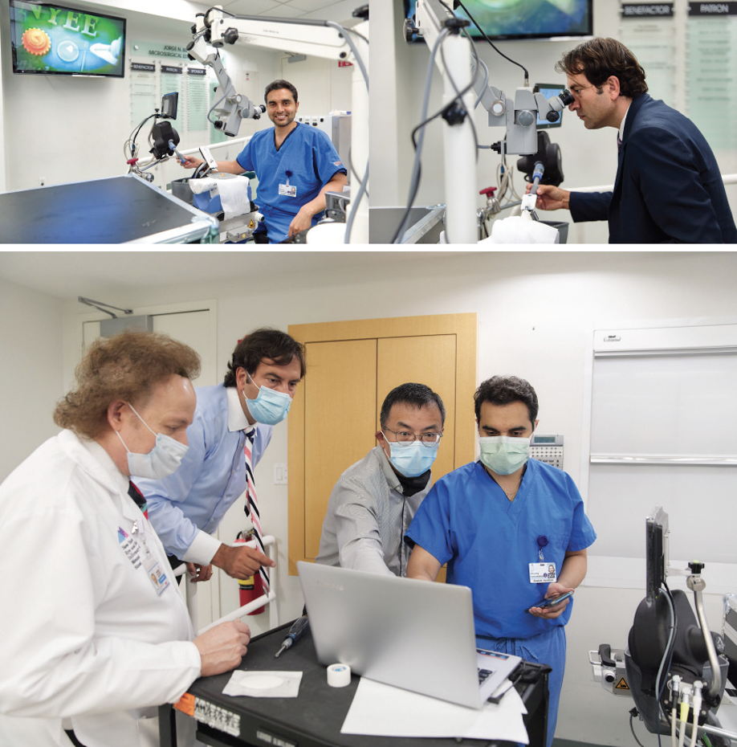


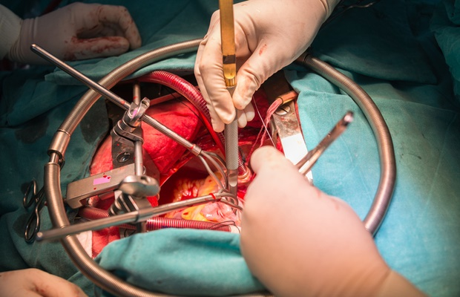
Introduction
A surgeon in a particular geographical location manipulate the surgeon console to operate on a remote patient
Benefits of Remote Robotic Surgery
Improves surgeons’ precision
Reduce patient blood loss
Ensures shorter hospital stay
Examples of Remote Robotic Surgery
Facial reconstruction surgery
Knot-tying
Suturing
Needle Passing
Trocar Insertion
Open heart surgery
Chowriappa, A., Wirz, R., Ashammagari, A.R. et al. Prediction from expert
demonstrations for safe tele-surgery. Int. J. Autom. Comput. 10, 487–497 (2013)

Slide 7
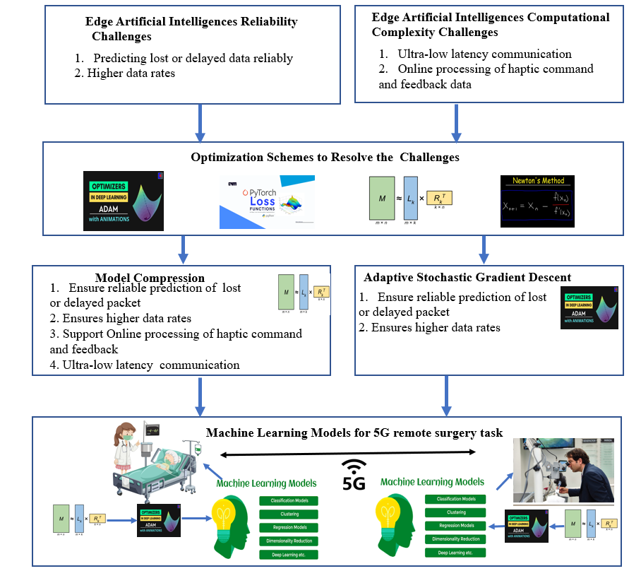
Challenges
Accurate Prediction
Ultra-low latency communication
Online processing of haptic command and feedback

Slide 8


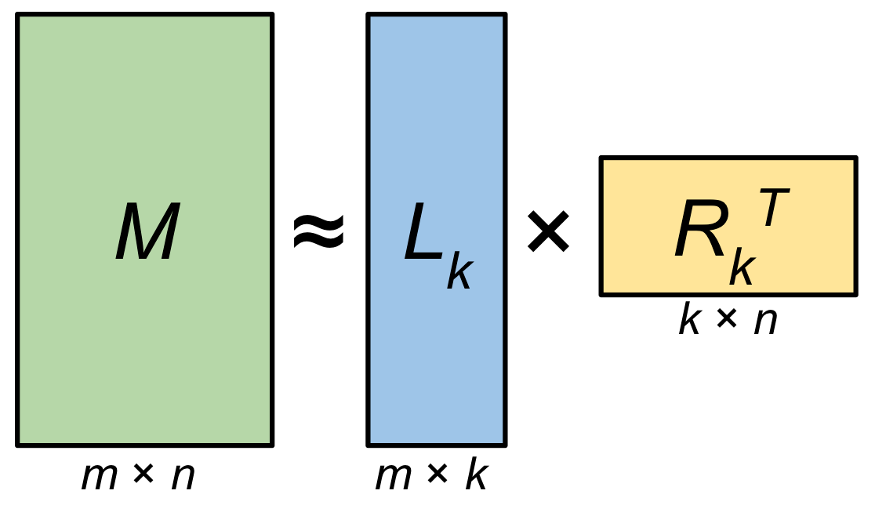
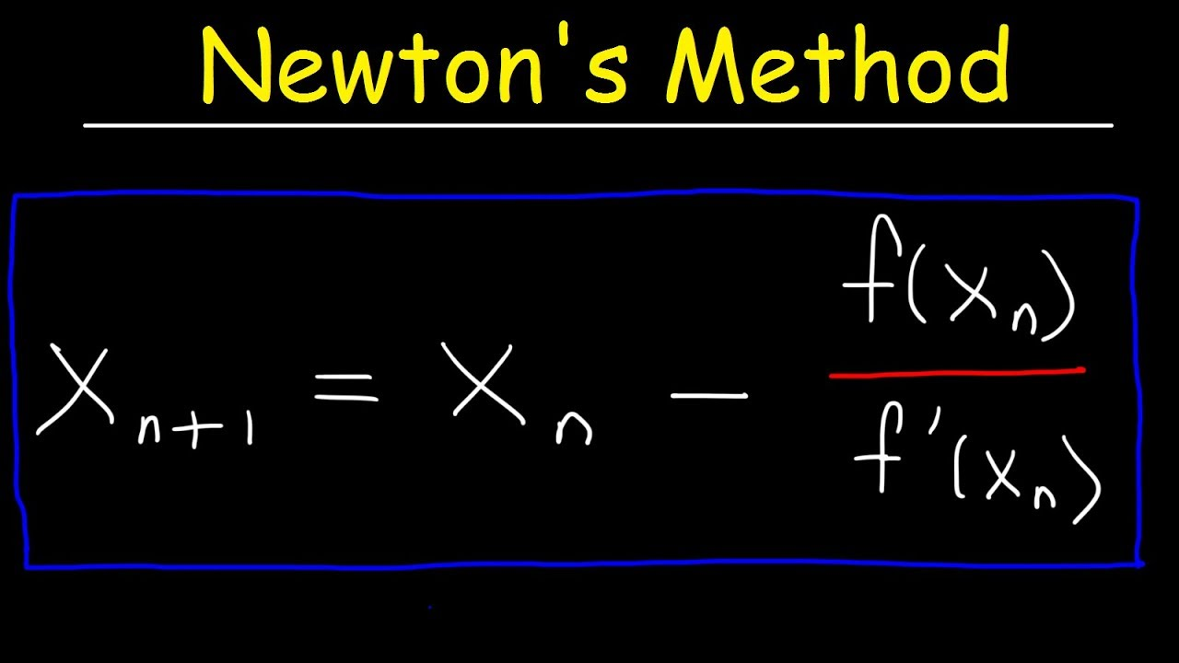
Thesis Statement
We have proposed enhanced stochastic gradient descent and low-rank matrix factorization for training machine learning models
The improvements focus on ensuring the convergence of these optimization schemes during machine learning training
These two optimization schemes collaborate, rather than compete, to enhance machine learning reliability for remote robotic surgery procedures

Slide 9
Contribution of the Thesis
An Improved Low Rank Matrix Factorization to Scale Machine Learning and Its Application to Remote Robotic Surgery [Published in IEEE TNSM]
Enhanced Stochastic Gradient Descent Algorithm for Machine Learning Training and Its Application in Remote Surgical Gesture Recognition [ Revising, IEEE transactions on Neural Network and Learning Systems]

Slide 10
An Improved Low Rank Matrix Factorization to Scale Machine Learning and Application to Remote Robotic Surgery [Published in IEEE TNSM]
Francis Boabang, A. Ebrahimzadeh, R. Glitho, H. Elbiaze, M. Maier and F. Belqami, "A Machine Learning Framework for Handling Delayed/Lost Packets in Tactile Internet Remote Robotic Surgery," in IEEE Transactions on Network and Service Management, doi: 10.1109/TNSM.2021.3106577

Slide 11
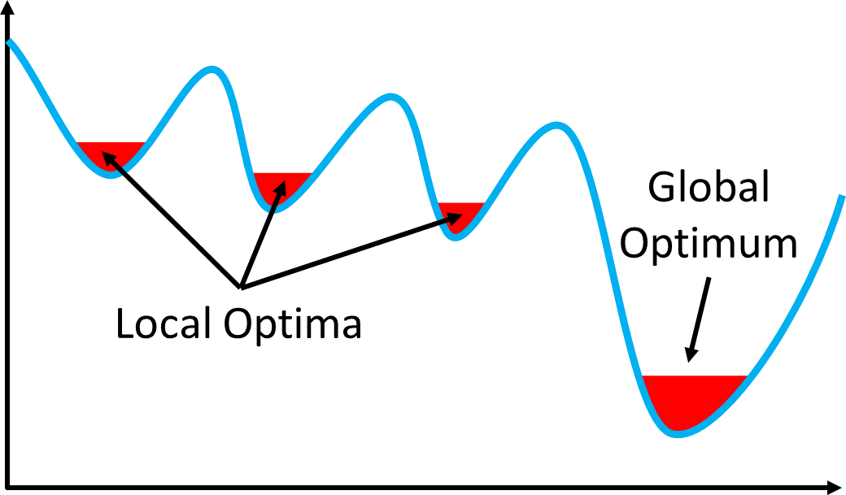
Review of Machine Learning Model Compression Techniques
Low rank and sparse matrix factorization
It can be used to scale ML methods and address delay and lost data online
Types of low rank and sparse matrix factorization
Nonconvex formulation of low rank and sparse matrix factorization
Convex formulation of low rank and sparse matrix factorization
Challenges of nonconvex formulation of low rank and sparse matrix factorization
Non-convex low-rank matrix factorization achieves higher accuracy with less computation compared to convex models
Non-convex formulations struggle to find quality solutions without good initial points
The hybrid model (convex and non-convex) can converge to quality solutions even with random initialization
The hybrid model is computationally efficient
Xiong L, Chen X, Schneider J. Direct robust matrix factorization for anomaly detection. In2011
IEEE 11th International Conference on Data Mining 2011 Dec 11 (pp. 844-853). IEEE.

Slide 12
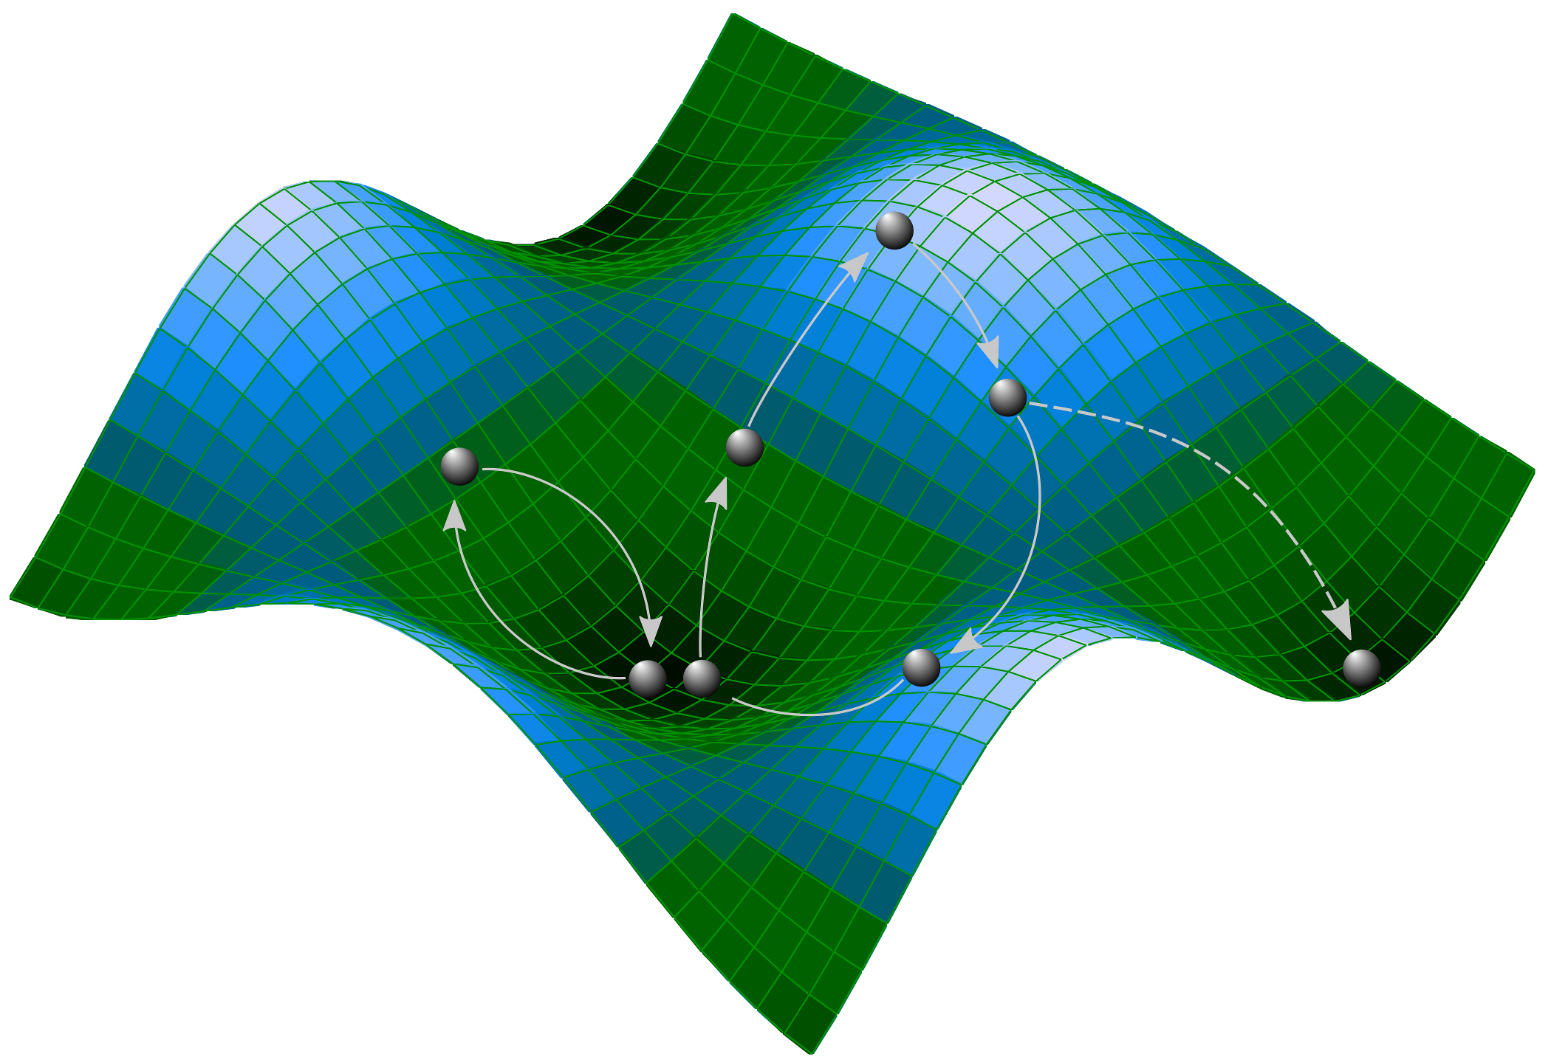
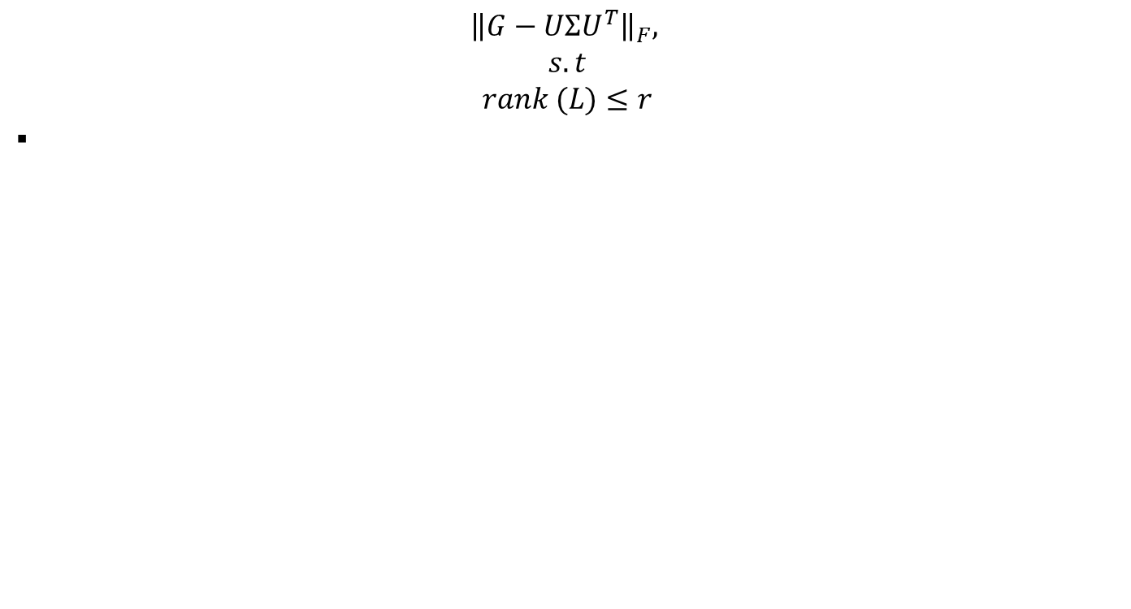
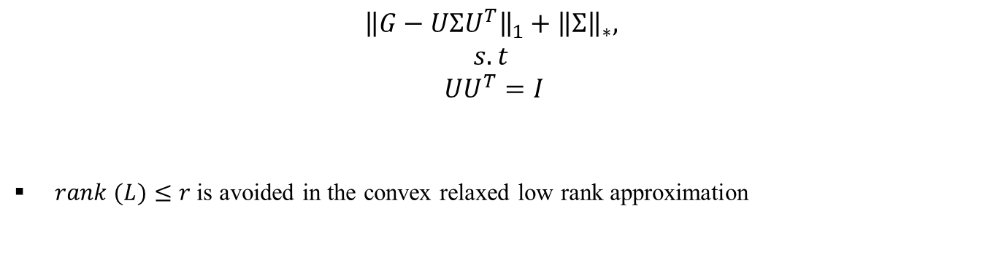
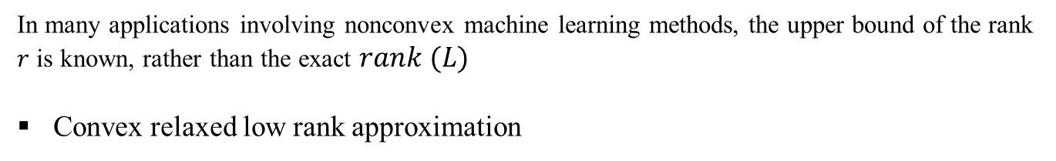
Nonconvex low-rank approximation
Overview of the Low-Rank Approximation
$${\left\|G−UΣU^{T}\right\|}_{F},$$
$$s.t$$
$$rank (L)≤r$$
In many applications involving nonconvex machine learning methods, the upper bound of the rank $r$ is known, rather than the exact $rank (L)$
Convex relaxed low rank approximation
$${\left\|G−UΣU^{T}\right\|}_{1}+{\left\|Σ\right\|}_{∗},$$
$$s.t$$
$$UU^{T}=I$$
$rank (L)≤r$ is avoided in the convex relaxed low rank approximation

Slide 13
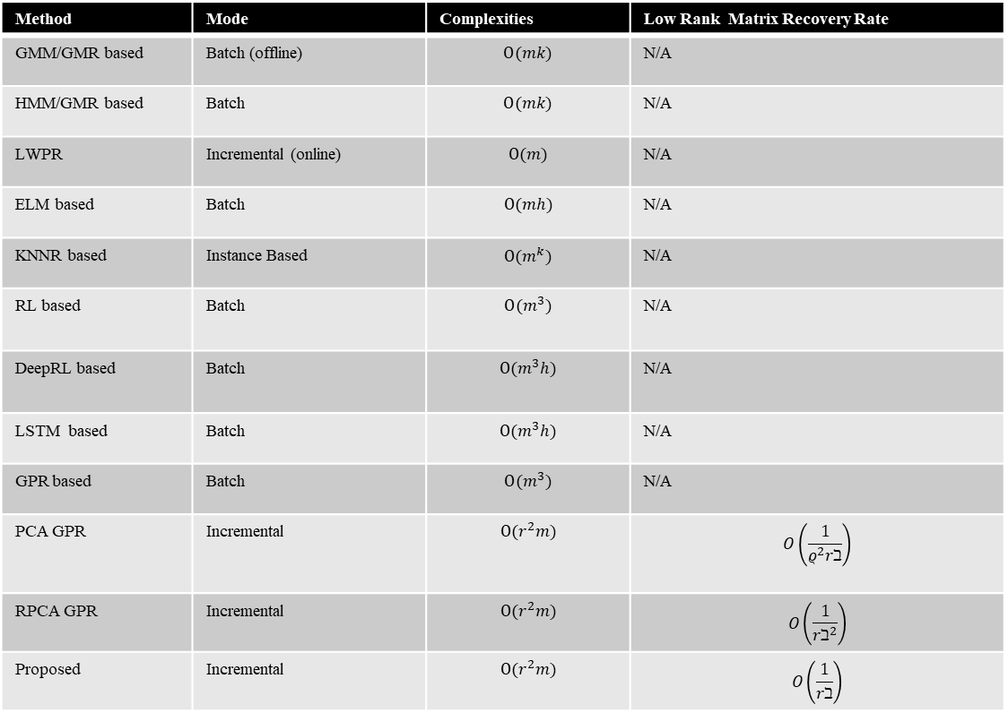
Related Work
Method | Mode | Complexities | Low Rank Matrix Recovery Rate
GMM/GMR based | Batch (offline) | $$Ο(mk)$$ | N/A
HMM/GMR based | Batch | $$Ο(mk)$$ | N/A
LWPR | Incremental (online) | $$Ο(m)$$ | N/A
ELM based | Batch | $$Ο(mh)$$ | N/A
KNNR based | Instance Based | $$Ο(m^{k})$$ | N/A
RL based | Batch | $$Ο(m^{3})$$ | N/A
DeepRL based | Batch | $$Ο(m^{3}h)$$ | N/A
LSTM based | Batch | $$Ο(m^{3}h)$$ | N/A
GPR based | Batch | $$Ο(m^{3})$$ | N/A
PCA GPR | Incremental | $$Ο(r^{2}m)$$ | $$O\left(\frac{1}{ρ^{2}rℶ}\right)$$
RPCA GPR | Incremental | $$Ο(r^{2}m)$$ | $$O\left(\frac{1}{rℶ^{2}}\right)$$
Proposed | Incremental | $$Ο(r^{2}m)$$ | $$O\left(\frac{1}{rℶ}\right)$$

Slide 14
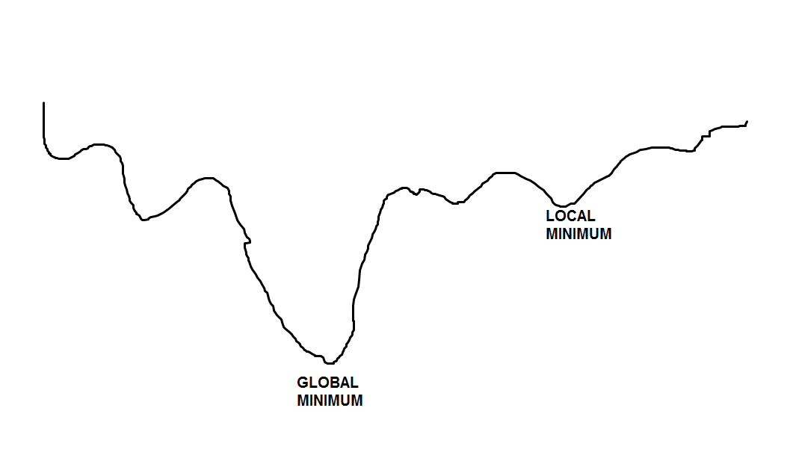
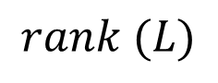
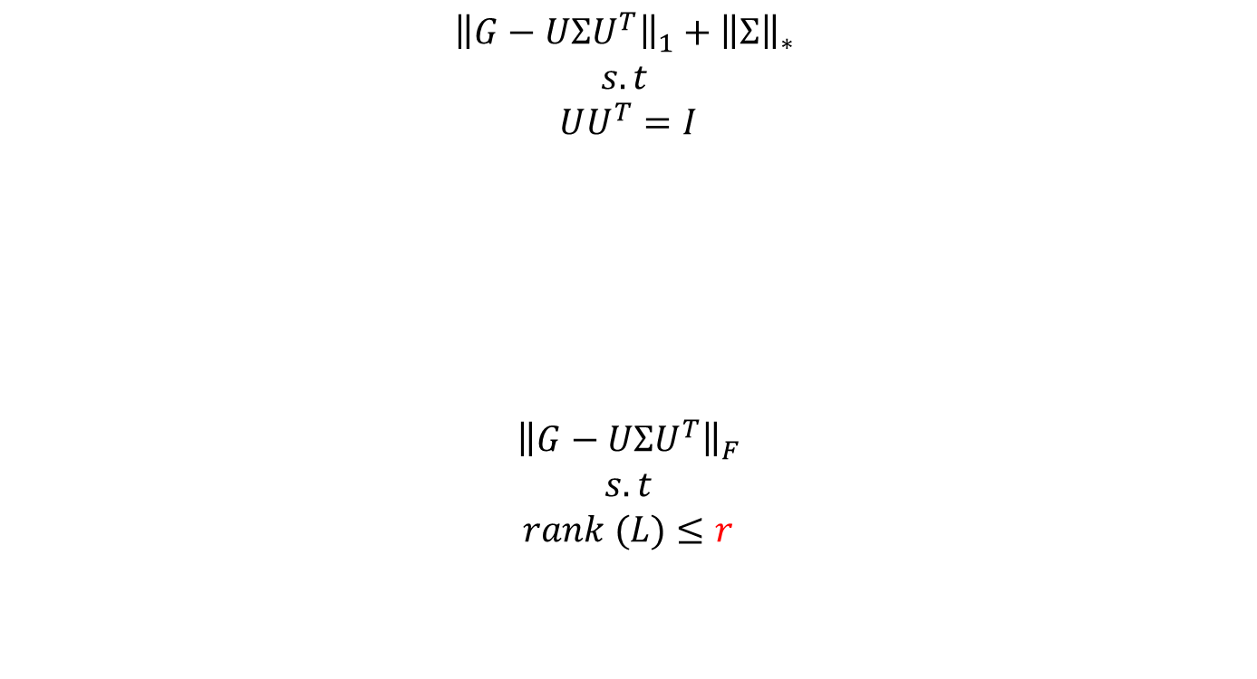
Proposed Method for the Covariance Matrix Update in Gaussian Process Regression
$${\left\|G−UΣU^{T}\right\|}_{1}+{\left\|Σ\right\|}_{∗}$$
$$s.t$$
$$UU^{T}=I$$
$${\left\|G−UΣU^{T}\right\|}_{F}$$
$$s.t$$
$$rank (L)≤r$$
Convex Relaxed Low rank
Approximation or Mean square error regularized
Initialization
$$rank (L)$$
Nonconvex Low Rank
Approximation
We first compute rank (L) using convex relaxed low-rank approximation and used
to initialize nonconvex low-rank approximation

Slide 15
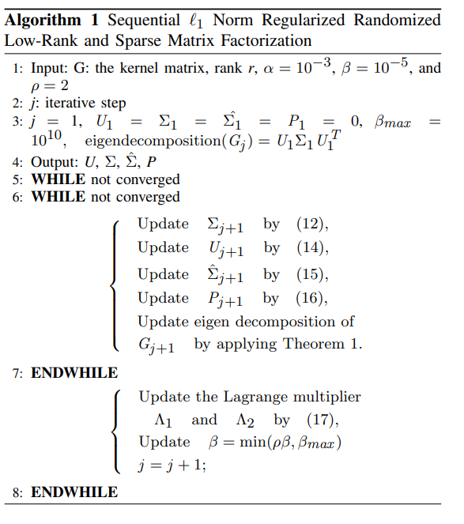
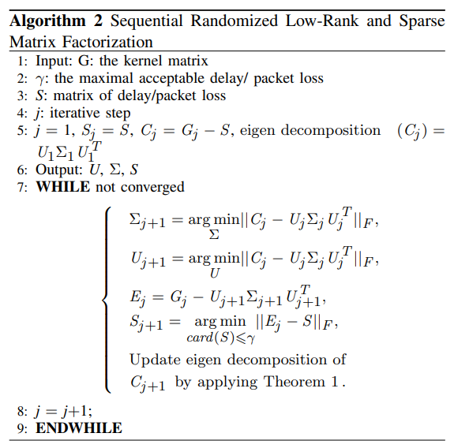
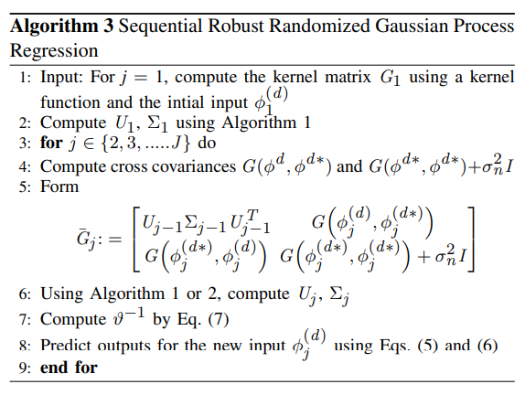
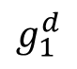

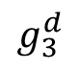
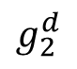
Proposed Solution (Bayesian View)
Convex Initialization of low rank matrix factorization
Nonconvex low rank matrix factorization
Machine Learning model: Gaussian Process Regression
Predicting packet loss and delay data
Gesture
$$×$$
$$g_{3}^{d}$$
$$g_{1}^{d}$$
$$g_{2}^{d}$$

Slide 16
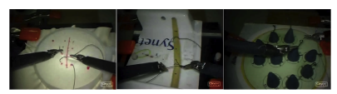
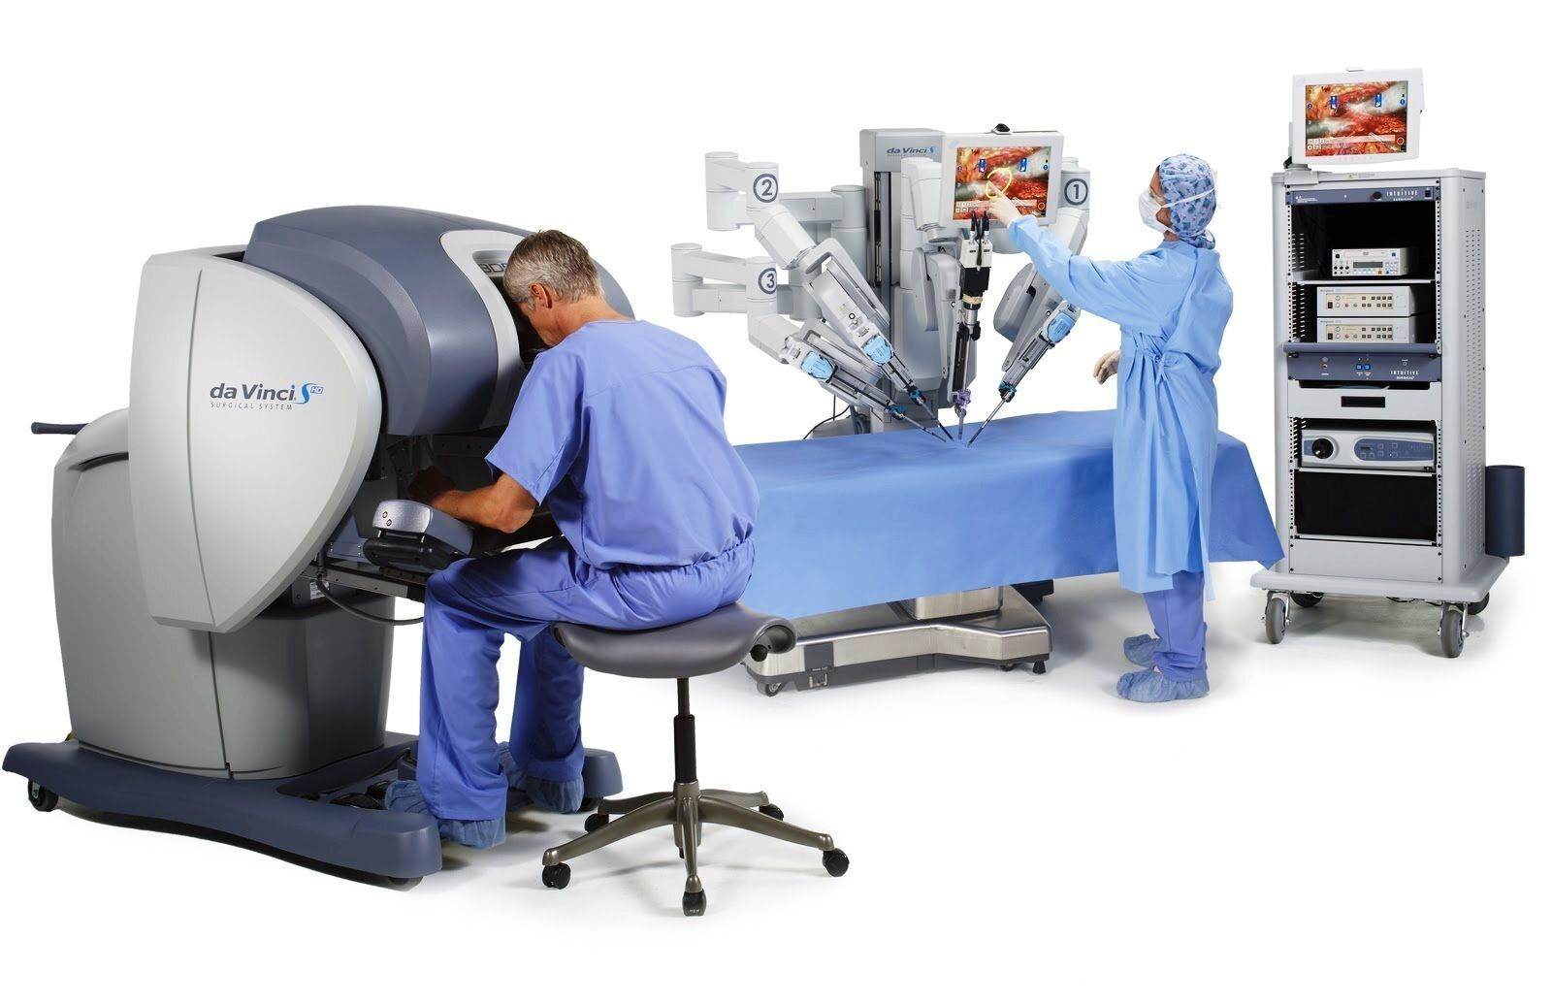
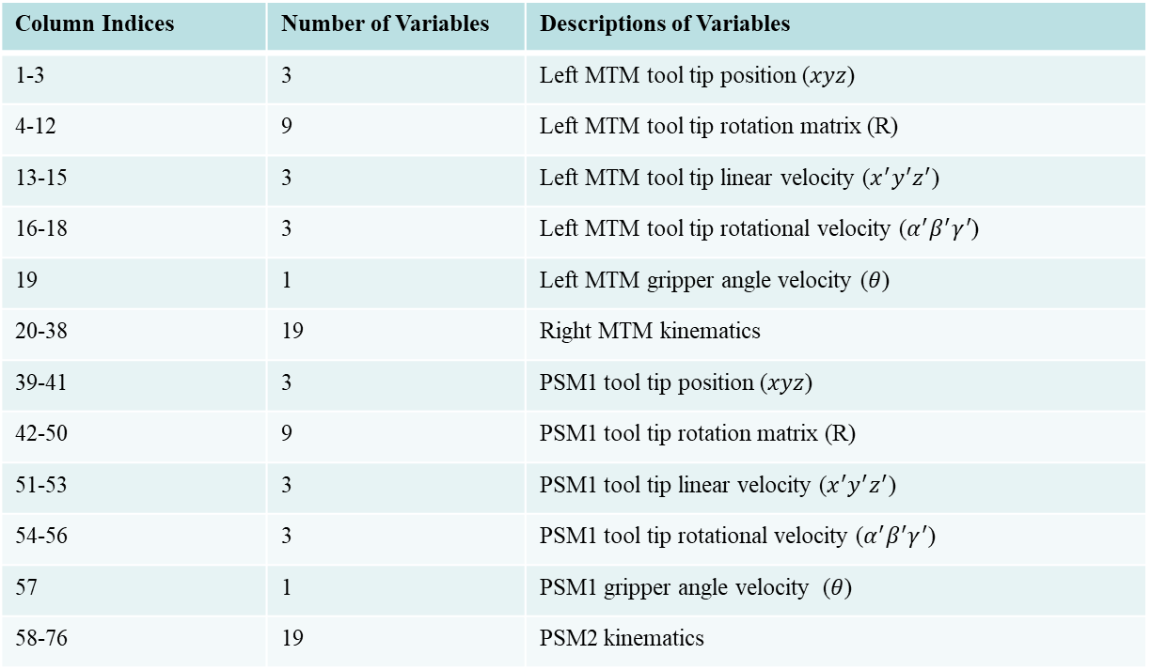
Kinematic Dataset of Surgical Task
Suturing
Knot-Tying
Needle passing
Column Indices | Number of Variables | Descriptions of Variables
1-3 | 3 | Left MTM tool tip position ($xyz$)
4-12 | 9 | Left MTM tool tip rotation matrix (R)
13-15 | 3 | Left MTM tool tip linear velocity ($x^{′}y^{′}z^{′}$)
16-18 | 3 | Left MTM tool tip rotational velocity ($α^{′}β^{′}γ^{′}$)
19 | 1 | Left MTM gripper angle velocity ($θ$)
20-38 | 19 | Right MTM kinematics
39-41 | 3 | PSM1 tool tip position ($xyz$)
42-50 | 9 | PSM1 tool tip rotation matrix (R)
51-53 | 3 | PSM1 tool tip linear velocity ($x^{′}y^{′}z^{′}$)
54-56 | 3 | PSM1 tool tip rotational velocity ($α^{′}β^{′}γ^{′}$)
57 | 1 | PSM1 gripper angle velocity ($θ$)
58-76 | 19 | PSM2 kinematics
I split the dataset into 90% training and 10% testing data
Gao, Yixin, et al. "Jhu-isi gesture and skill assessment working set (jigsaws): A surgical activity dataset for human motion modeling." MICCAI workshop: M2cai. Vol. 3. No. 2014. 2014.

Slide 17
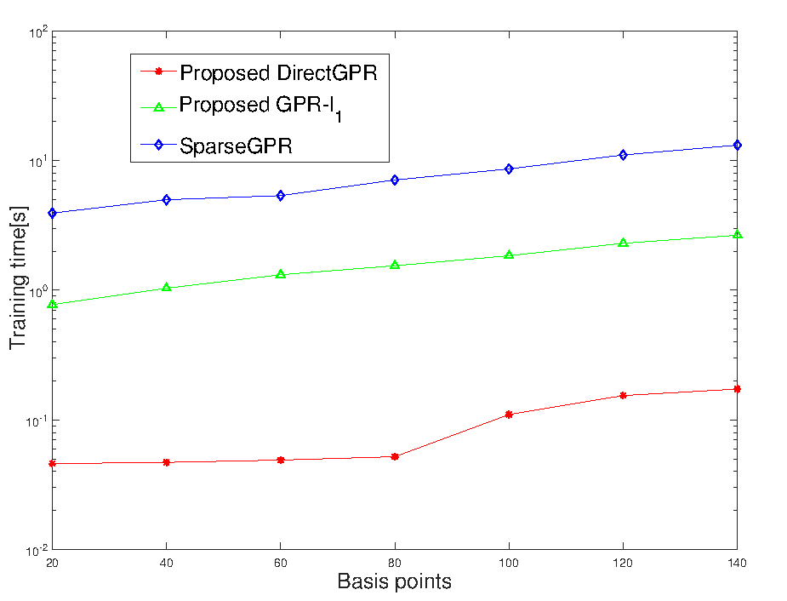
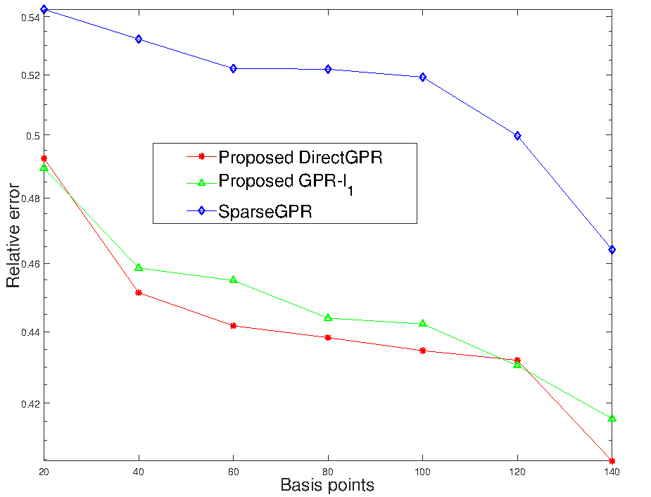
Evaluation (Knot-Tying Task)

Slide 18
Evaluation
We use haptic traces of different surgical tasks..
Francis Boabang, A. Ebrahimzadeh, R. Glitho, H. Elbiaze, M. Maier and F. Belqami, "A Machine Learning Framework for Handling Delayed/Lost Packets in Tactile Internet Remote Robotic Surgery," in IEEE Transactions on Network and Service Management, doi: 10.1109/TNSM.2021.3106577

Slide 19
First Contribution Conclusion
Developed an efficient, lightweight framework for predicting haptic commands in robotic surgery
Numerical simulations show the model balances performance and computational cost
The proposed DirectGPR alternates between convex relaxation and nonconvex optimization to optimize a smooth, nonconvex proxy for the original cost function

Slide 20
Francis. Boabang, Enhanced Stochastic Gradient Descent Algorithm for Machine Learning Training and Its Application in Remote Surgical Gesture Recognition, (Under Review in IEEE Transaction on Neural Network and Learning Systems)

Slide 21
A Review of Stochastic Gradient Descent (SGD)
Stochastic gradient descent uses the same learning rate for all the coordinates
Adaptive stochastic gradient descent uses different effective learning rate for different coordinates
The idea is to propose a new adaptive learning rate to learn the varying stepsize for different coordinates
Each coordinate has it own learning rate
Examples of adaptive stochastic gradient descent
ADAGRAD – Conventional adaptive stochastic gradient descent
ADAM- Adaptive Moment Estimation [1]
PADAM-Partial Adaptive Moment Estimation
[1] Kingma, Diederik P., and Jimmy Ba. "Adam: A method for stochastic optimization." arXiv preprint arXiv:1412.6980 (2014).
Zaheer, Manzil, et al. "Adaptive methods for nonconvex optimization." Advances in Neural Information
Processing Systems. 2018.

Slide 22
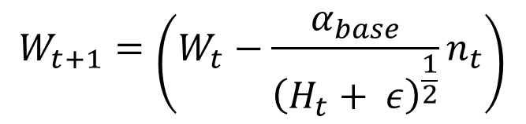
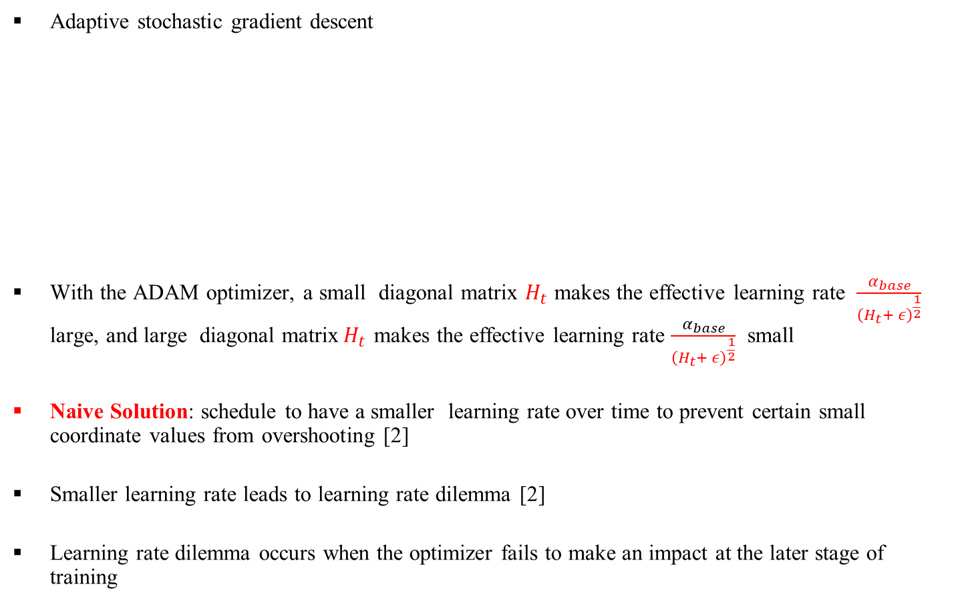
A Review of Adaptive Stochastic Gradient Descent
Adaptive stochastic gradient descent
With the ADAM optimizer, a small diagonal matrix $H_{t}$ makes the effective learning rate $\frac{α_{base}}{{\left(H_{t}+ ε\right)}^{\frac{1}{2}}}$ large, and large diagonal matrix${ H}_{t}$ makes the effective learning rate $\frac{α_{base}}{{\left(H_{t}+ ε\right)}^{\frac{1}{2}}}$ small
Naive Solution: schedule to have a smaller learning rate over time to prevent certain small coordinate values from overshooting [2]
Smaller learning rate leads to learning rate dilemma [2]
Learning rate dilemma occurs when the optimizer fails to make an impact at the later stage of training
Adaptive Moment Estimation(ADAM)
$$W_{t+1}=\left(W_{t}−\frac{α_{base}}{{\left(H_{t}+ ε\right)}^{\frac{1}{2}}}n_{t}\right)$$
[2] Chen J, Zhou D, Tang Y, Yang Z, Cao Y, Gu Q. Closing the generalization gap of adaptive gradient methods in training deep neural networks. arXiv preprint arXiv:1806.06763. 2018 Jun 18.

Slide 23
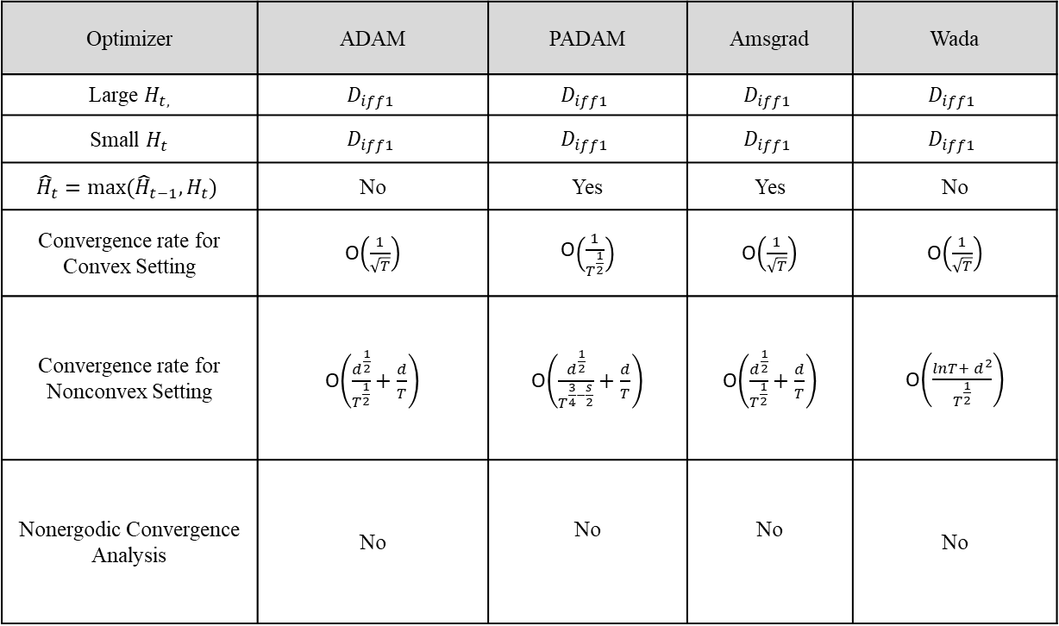
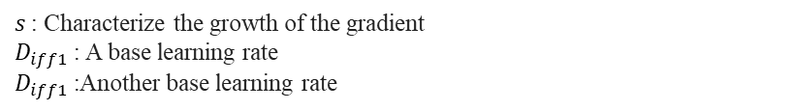
Related Work
Summary of works related to Adaptive Stochastic Gradient Descent
Optimizer | ADAM | PADAM | Amsgrad | Wada
Large $H_{t,}$ | $$D_{iff1}$$ | $$D_{iff1}$$ | $$D_{iff1}$$ | $$D_{iff1}$$
Small $H_{t}$ | $$D_{iff1}$$ | $$D_{iff1}$$ | $$D_{iff1}$$ | $$D_{iff1}$$
$${\hat{H}}_{t}=max⁡({\hat{H}}_{t−1},H_{t})$$ | No | Yes | Yes | No
Convergence rate for Convex Setting | O$\left(\frac{1}{\sqrt{T}}\right)$ | O$\left(\frac{1}{T^{\frac{1}{2}}}\right)$ | O$\left(\frac{1}{\sqrt{T}}\right)$ | O$\left(\frac{1}{\sqrt{T}}\right)$
Convergence rate for Nonconvex Setting | O$\left(\frac{d^{\frac{1}{2}}}{T^{\frac{1}{2}}}+\frac{d}{T}\right)$ | O$\left(\frac{d^{\frac{1}{2}}}{T^{\frac{3}{4}−\frac{s}{2}}}+\frac{d}{T}\right)$ | O$\left(\frac{d^{\frac{1}{2}}}{T^{\frac{1}{2}}}+\frac{d}{T}\right)$ | O$\left(\frac{{lnT+ d}^{2}}{T^{\frac{1}{2}}}\right)$
Nonergodic Convergence Analysis | No | No | No | No
$s$: Characterize the growth of the gradient
$D_{iff1}$: A base learning rate
$D_{iff1}$:Another base learning rate

Slide 24

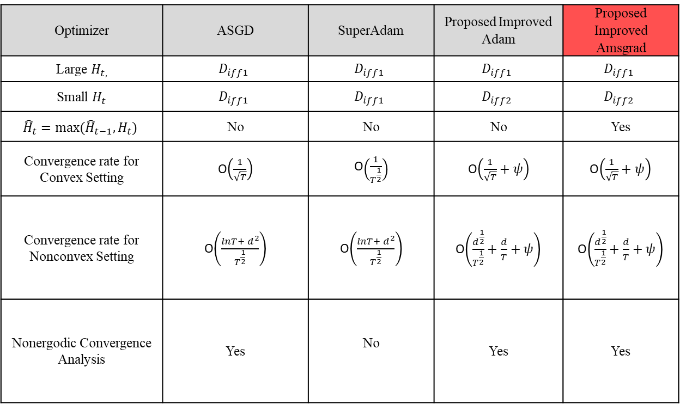
Related Work
Summary of works related to Adaptive Stochastic Gradient Descent
Optimizer | ASGD | SuperAdam | Proposed Improved Adam | Proposed Improved Amsgrad
Large $H_{t,}$ | $$D_{iff1}$$ | $$D_{iff1}$$ | $$D_{iff1}$$ | $$D_{iff1}$$
Small $H_{t}$ | $$D_{iff1}$$ | $$D_{iff1}$$ | $$D_{iff2}$$ | $$D_{iff2}$$
$${\hat{H}}_{t}=max⁡({\hat{H}}_{t−1},H_{t})$$ | No | No | No | Yes
Convergence rate for Convex Setting | O$\left(\frac{1}{\sqrt{T}}\right)$ | O$\left(\frac{1}{T^{\frac{1}{2}}}\right)$ | O$\left(\frac{1}{\sqrt{T}}+ψ\right)$ | O$\left(\frac{1}{\sqrt{T}}+ψ\right)$
Convergence rate for Nonconvex Setting | O$\left(\frac{{lnT+ d}^{2}}{T^{\frac{1}{2}}}\right)$ | O$\left(\frac{{lnT+ d}^{2}}{T^{\frac{1}{2}}}\right)$ | O$\left(\frac{d^{\frac{1}{2}}}{T^{\frac{1}{2}}}+\frac{d}{T}+ψ\right)$ | O$\left(\frac{d^{\frac{1}{2}}}{T^{\frac{1}{2}}}+\frac{d}{T}+ψ\right)$
Nonergodic Convergence Analysis | Yes | No | Yes | Yes
$ψ$: Characterize the growth of the gradient
$D_{iff1}$: A base learning rate
$D_{iff1}$:Another base learning rate

Slide 25
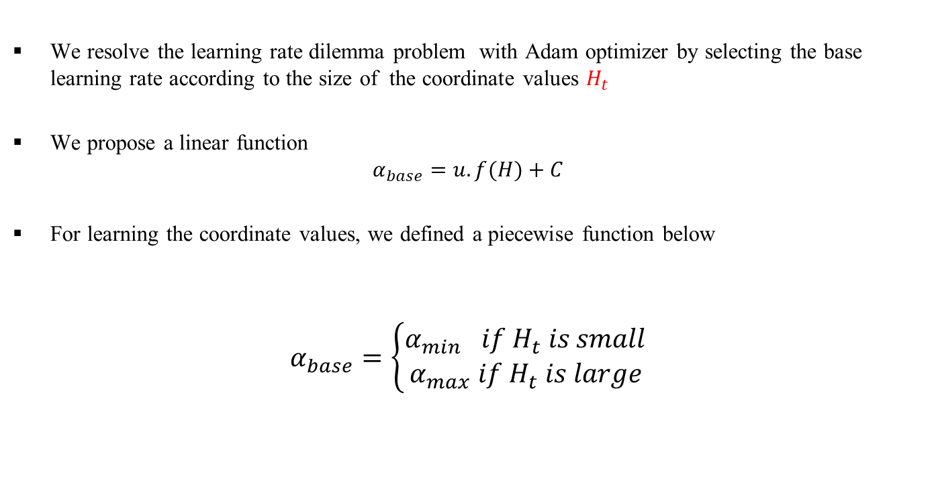
Proposed Adaptive Stochastic Gradient Descent Algorithm
We resolve the learning rate dilemma problem with Adam optimizer by selecting the base learning rate according to the size of the coordinate values $H_{t}$
We propose a linear function
$$α_{base}=u.f(H)+C$$
For learning the coordinate values, we defined a piecewise function below
$$α_{base}=\left\{\begin{aligned}α_{min} if H_{t} is small \\ α_{max} if H_{t} is large\end{aligned}\right.$$
Piecewise function for base learning rate selection

Slide 26
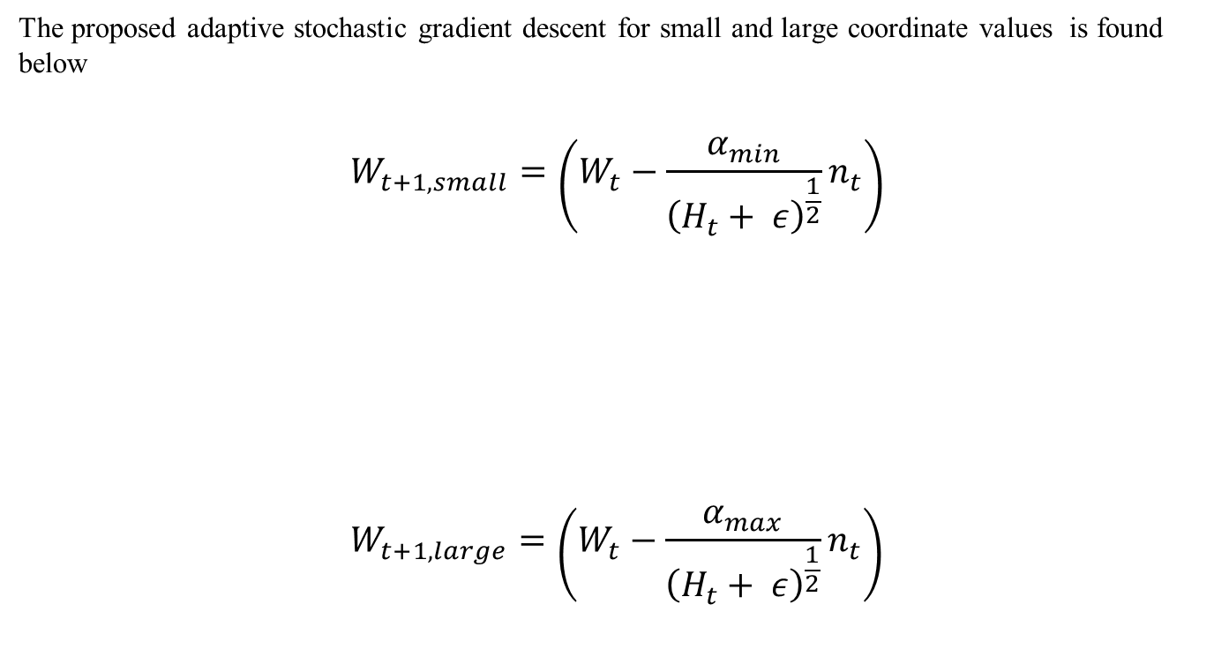
Proposed Adaptive Stochastic Gradient Descent
The proposed adaptive stochastic gradient descent for small and large coordinate values is found below
$$W_{t+1,small}=\left(W_{t}−\frac{α_{min}}{{\left(H_{t}+ ε\right)}^{\frac{1}{2}}}n_{t}\right)$$
$$W_{t+1,large}=\left(W_{t}−{\frac{α_{max}}{{\left(H_{t}+ ε\right)}^{\frac{1}{2}}}n}_{t}\right)$$
Small coordinate values update rule
Large coordinate values update rule

Slide 27
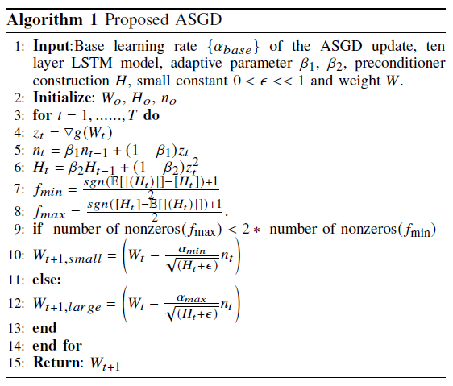
Proposed Algorithm (Improved Adam/Amsgrad)
Contribution : Select large
or small coordinate values
update rule

Slide 28
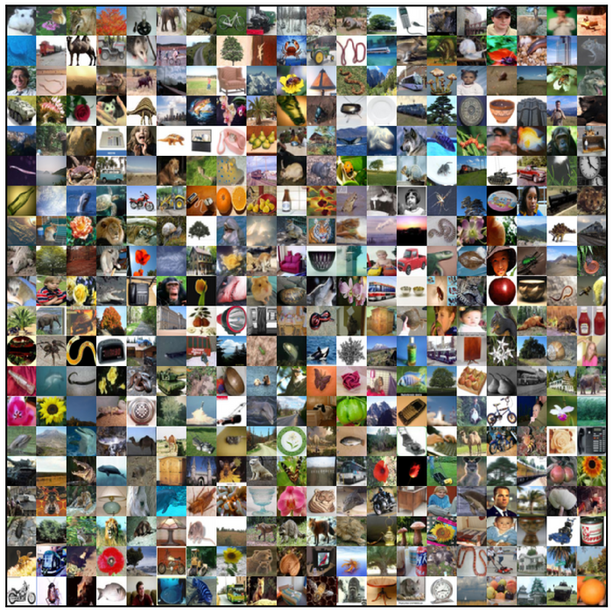
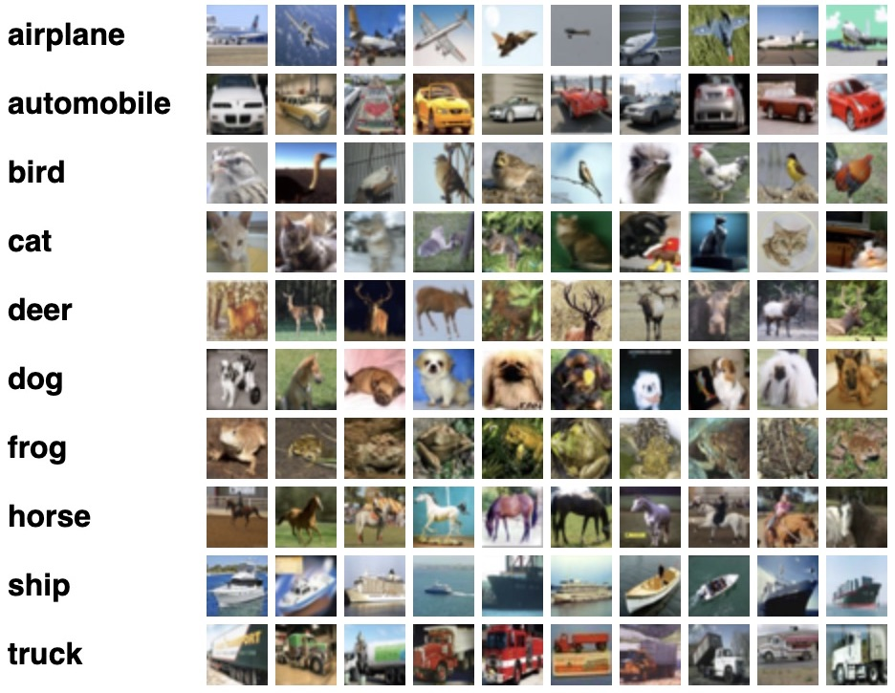
CIFAR-100 Image Dataset
500 training images per class
100 testing images per class
100 classes
20 Super classes with 5 Subclasses

Slide 29
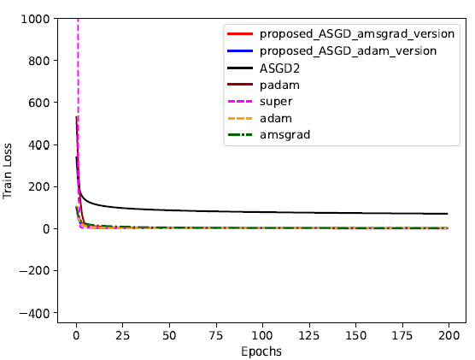
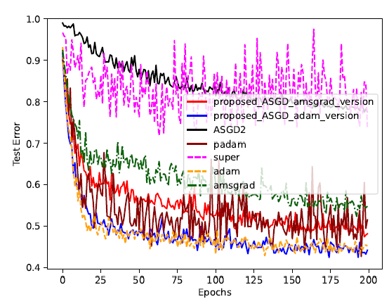
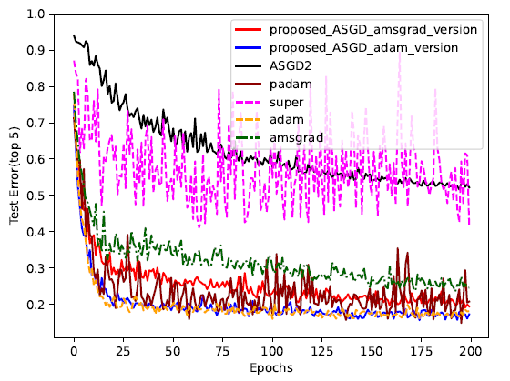
Image Classification Experiment (WideResNet with Batch 64)

Slide 30
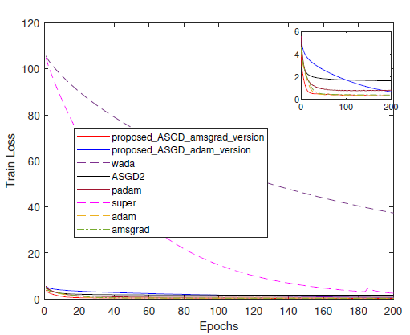
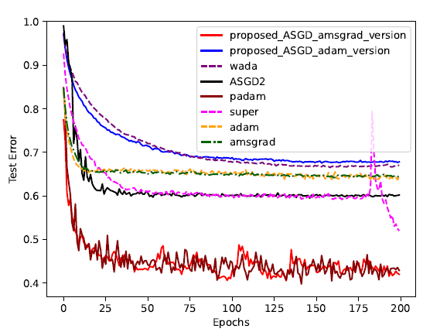
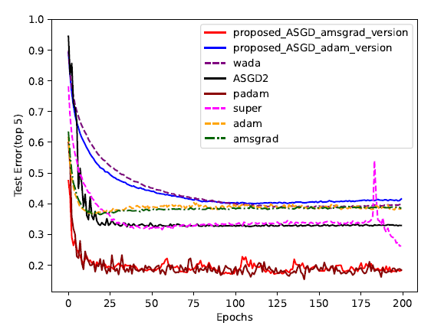
Image Classification Experiment (VGG16-Net with Batch 64)

Slide 31
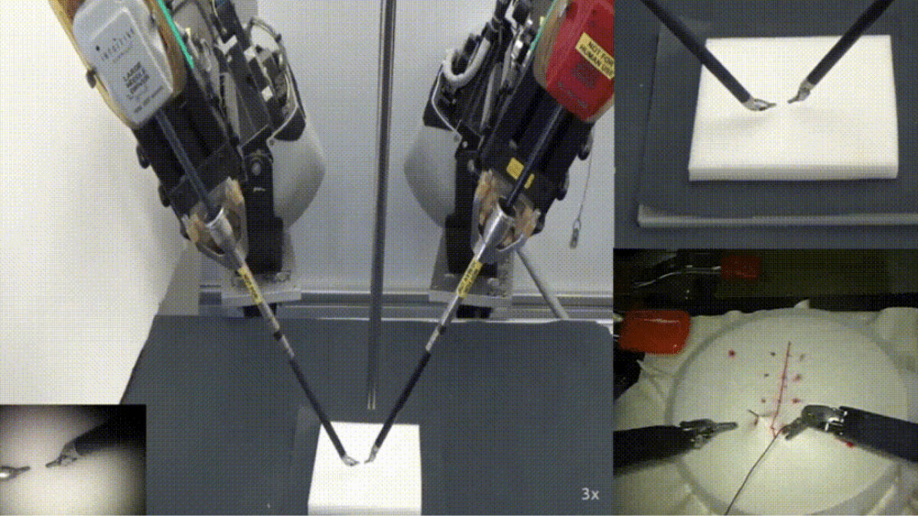
Suturing Video Dataset
Gestures | Vocabulary
y1 | Reaching for needle with right hand
y2 | Positioning needle
y3 | Pushing needle through tissue
y4 | Transferring needle from left to right
y5 | Moving to center with needle in grip
y6 | Pulling suture with left hand
y8 | Orienting needle
y9 | Using right hand to help tighten suture
y10 | Loosening more suture
y11 | Dropping suture and moving to end points
Gestures: y1, y2, y3, y4, y5, y6, y8, y9, y10,y11
Less frequently occurring gestures: y1, y5, y8, y9, y10
We split the dataset into 90% training and 10% testing data
Gao, Yixin, et al. "Jhu-isi gesture and skill assessment working set (jigsaws): A surgical activity dataset for human motion modeling." MICCAI workshop: M2cai. Vol. 3. No. 2014. 2014.

Slide 32
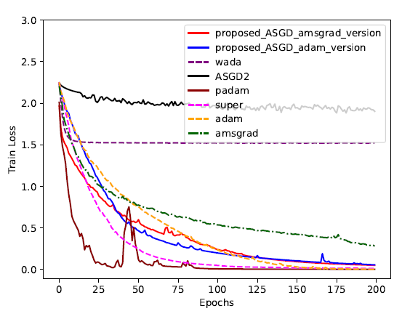
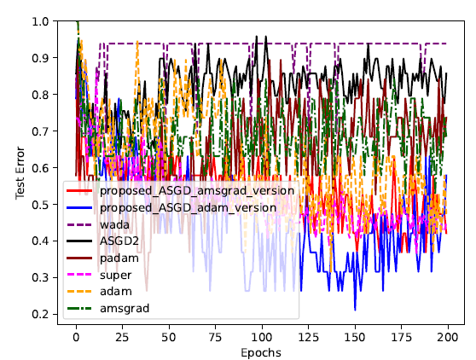
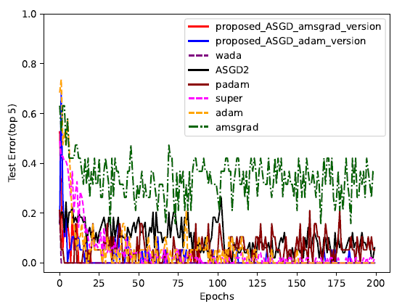
Remote Surgical Gesture Recognition (2D CNN LSTM)

Slide 33
Second contribution Conclusion
For shallow neural networks, our proposed ASGD enhances generalization performance by excluding the
maximum second-order momentum matrix
In deeper neural networks, incorporating the maximum second-order momentum matrix helps counteract
rapidly diminishing gradients, benefiting the optimizer
The proposed ASGD method achieved the optimal outcome due to our approach to addressing the small
learning rate dilemma problem

Slide 34
Conclusion of the Thesis
The proposed approach performs best by using a convex low-rank matrix factorization as the starting point for the nonconvex method
The proposed ASGD method achieved the optimal outcome due to our approach to
addressing the small learning rate dilemma problem
Model compression makes factorized updates to weight or covariance matrices more efficient, while ASGD is effective but costly for unfactorized updates
Combining ASGD with model compression enables factorized updates, boosting efficiency and performance for machine learning models in tactile internet applications

Slide 35
Limitations
A predefined number of iterations alternates between convex relaxed low-rank matrix factorization and nonconvex low-rank matrix factorization to scale machine learning
The proposed ASGD algorithm cannot automatically adjust the maximum second-order momentum matrix between deep and shallow learning models, affecting remote robotic surgery performance.
The proposed ASGD does not address the class imbalance in the JIGSAW robotic surgery dataset
The limited availability of publicly accessible robotic surgery data for training the model has impeded our ability to pinpoint limitations in the algorithm for future enhancement

Slide 36
Future Work
Combine sparse GPs with nonconvex regularization and efficient convex preserving strategies
to improve predictive performance
Expand the base learning selection strategy to other models, such as Adabrief, to assess performance
in strongly convex settings
Evaluate the proposed ASGD across various neural networks

Slide 37
Machine Learning Optimization Methods and Their Application to Predicting T-Cell Differentiation Using GNNs and Reinforcement Learning
Francis Boabang
Link to source codes
37
Notes:
Proactive prediction for haptic feedback in remote robotic surgery
Introduction
Remote Robotic Surgery (including overlapping surgery)
Haptic Feedback Prediction
Proactive Prediction
Related Work
Evaluation

Slide 38
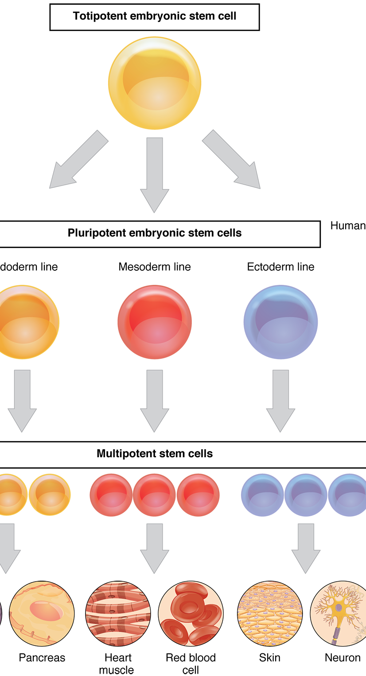
Stem Cell Differentiation and Machine Learning: Tunable Stem Cell Differentiation
Stem cells are pluripotent cells, meaning they have the ability to differentiate into any cell type. They play a critical role in applications such as tissue regeneration, cell fate determination, and immunotherapies
In the context of machine learning, stem cell differentiation can be guided using tunable parameters such as:
Loss functions
Constraints
Regularization terms
optimizers
These parameters help steer the learning model toward predicting or influencing a specific cell fate or lineage
Edgar JM, Michaels YS, Zandstra PW. Multi-objective optimization reveals time- and dose-dependent inflammatory cytokine-mediated regulation of human stem cell derived T-cell development.
Jones, Ross D., et al. "Tunable differentiation of human CD4+ and CD8+ T cells from pluripotent stem cells." bioRxiv (2024): 2024-10.
Jeffreys, Nicholas. "Amplifying mechanotransduction in human T-cell development to enhance immunotherapies." (2024).

Slide 39
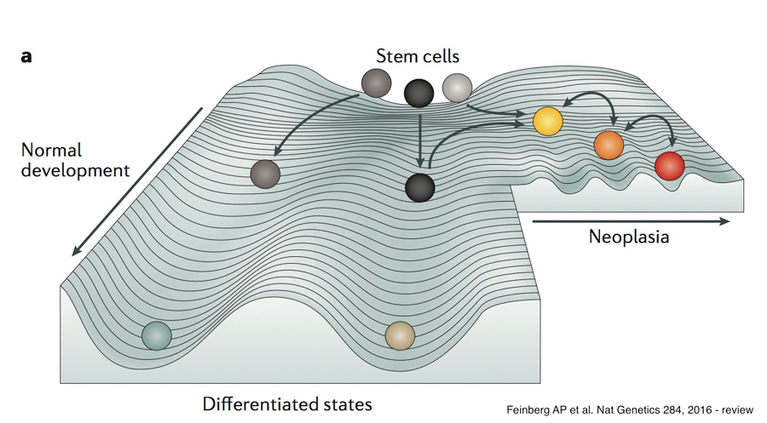
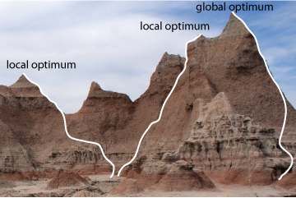
Tuning Mechanisms in Machine Learning for Stem Cell Differentiation
Optimization Landscape: Mechanical and biochemical signals form an optimization landscape, where these forces influence stem cell fate
Hyperparameter Tuning: Fine-tuning the model’s hyperparameters (e.g., learning rate, batch size, regularization strength) helps guide stem cells toward specialized or targeted cell lineages

Slide 40
IQCELL: Gene Regulatory Network and Logical Rule Inference for Predicting Effect of Gene Perturbation
IQCELL: predicting effect of gene perturbation on developmental trajectories
The paper formulates gene regulatory network (GRN) as boolean logic or differential equation
They are executable logical networks that simulate perturbed and normal cell gene expression trajectories
Prediction or inference of gene was done via logical rule inference
Heydari, Tiam, et al. "IQCELL: A platform for predicting the effect of gene perturbations on developmental trajectories using single-cell RNA-seq data." PLoS Computational Biology 18.2 (2022): e1009907.

Slide 41
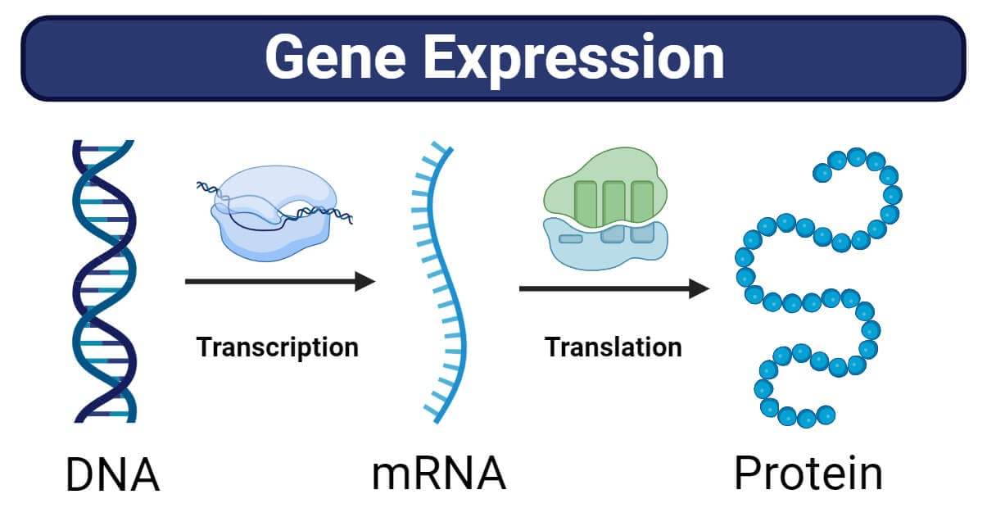
Recasting IQCELL as GNN + Reinforcement Learning
We reframe GRN as graph neural network with markov decision process
Node denote the gene state
Action: perturbation or knockout of gene (crisper perturbation or RNAi)
Reward desired cell fate determination
The transition of one gene state to another was described as gene expression
Dataset:
Mouse T-cell development

Slide 42
Dynamic Simulation with Reinforcement Learning
Deep Reinforcement will be used to predict the outcome of the gene perturbation
DRL uses policy inference instead of logical rule inference for gene expression prediction.
There two types of DRL policy inference
On-policy Methods
PPO (Proximal Policy Optimization)
TRPO (Trust Region Policy Optimization)
A2C (Advantage Actor-Critic)
REINFORCE
Off-policy Methods
TD (Temporal Difference Learning)
SAC (Soft Actor-Critic)
DQN (Deep Q-Networks)

Slide 43
Motivation for PPO Modification for Stem Cell differentiation
Problem: Gene expression prediction under knockouts/perturbations produces sparse datasets
Challenge: Standard PPO struggles because coordinate values can vary widely depending on perturbation thresholds
Goal: Develop a more robust optimization strategy for reinforcement learning in GRN-based simulations
Start from Proximal Policy Optimization (PPO), a gradient-based RL optimizer.
Modify PPO using insights from slides 25 followed by insights from slides 14

Slide 44
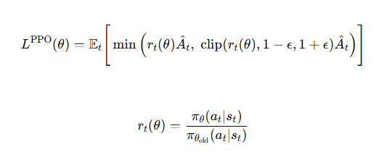

Standard PPO

Slide 45




Modified PPO via the Proposed ASGDAdam/Amsgrad
A modification of the version in my Ph.D. thesis slides 25 to improve the prediction and classification performance
Advantage: PPOASGDADAM can handle large/small coordinate variations better than standard PPO.
Impact: Reduces the mean square error for gene perturbation outcomes in sparse single-cell datasets.

Slide 46
Motivation for using Low Rank Matrix Factorization for Gene Perturbation Effect Prediction
Direct Reinforcement Learning (RL) on large Graph Neural Network (GNN)-based Gene Regulatory Networks (GRNs) is computationally prohibitive
Scaling DRL requires parameter-efficient strategies
LoRA (Low-Rank matrix factorization): Efficiently scale weights
Multistage training (convex → nonconvex): Stabilizes learning, allowing RL to scale to larger networks without diverging taking insights from slides 11, 12 and 14

Slide 47


Modified PPO via the Proposed Multistage Low Rank Matrix Factorization
Gene expression landscapes are uneven
Naive RL may get trapped in local optima
Multistage PPO allows:​
Convex stage : smooth, stable exploration​
Nonconvex stage: fine-tuned exploitation, capturing complex non-linear interactions

Slide 48
Future Work-Foundational Models for Stem Cell Differentiation
Cell embeddings (e.g., scBERT, UCE, Geneformer)
Capture cellular states and structure
Not directly comparable to ground-truth transcriptomic profiles (gene counts, cell fate determination, perturbation effects)
Challenge
Need to map embeddings to gene expression values
Method
Linear decoders:
Multilayer perceptron (MLP)
With or without Reinforcement Learning (RL)
Activation functions:
Multistage convex (GReLU) & nonconvex (ReLU) activation functions
to enhance performance
GReLU (Graph-adaptive ReLU with fixed threshold) followed by
standard ReLU activation function
Strongly convex optimizer for improved convergence & stability
Hybrid policy optimization:
Combine TRPO + PPO in a multistage setup
Leverage second-order policy (TRPO) updates for robustness

Slide 49
Thank you

